Slide 1


Neural Models for Document Ranking
Joint work with Nick Craswell, Fernando Diaz, Federico Nanni, Matt Magnusson, and Laura Dietz
Bhaskar Mitra
Principal Applied Scientist
Microsoft Research and AI
Research Student
Dept. of Computer Science
University College London

Slide 2


papers We will discuss
Learning to Match Using Local and Distributed Representations of Text for Web Search
Bhaskar Mitra, Fernando Diaz, and Nick Craswell, in Proc. WWW, 2017.
https://dl.acm.org/citation.cfm?id=3052579
Benchmark for Complex Answer Retrieval
Federico Nanni, Bhaskar Mitra, Matt Magnusson, and Laura Dietz, in Proc. ICTIR, 2017.
https://dl.acm.org/citation.cfm?id=3121099

Slide 3


The document ranking task
Given a query rank documents according to relevance
The query text has few terms
The document representation can be long (e.g., body text) or short (e.g., title)
query
search engine w/ an index of retrievable items
ranked results

Slide 4
This talk is focused on ranking documents based on their long body text

Slide 5
Challenges in short vs. long text retrieval
Short-text
Vocabulary mismatch more serious problem
Long-text
Documents contain mixture of many topics
Matches in different parts of a long document contribute unequally
Term proximity is an important consideration

Slide 6
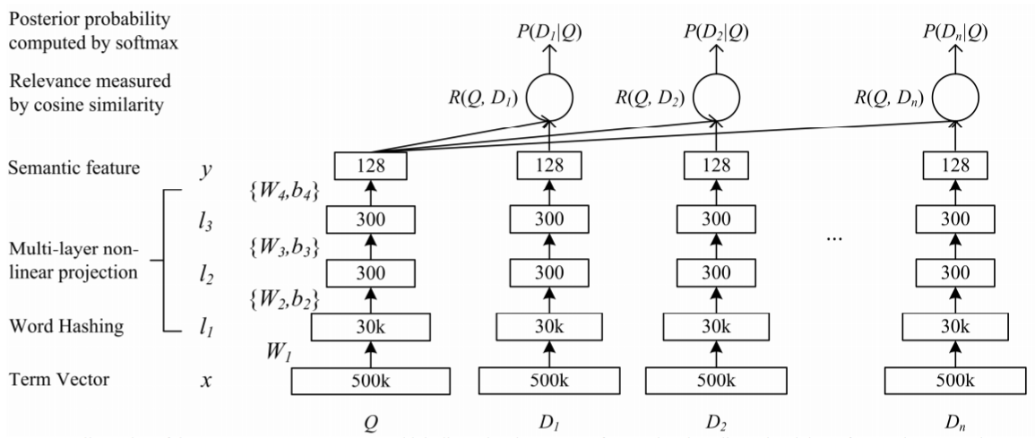
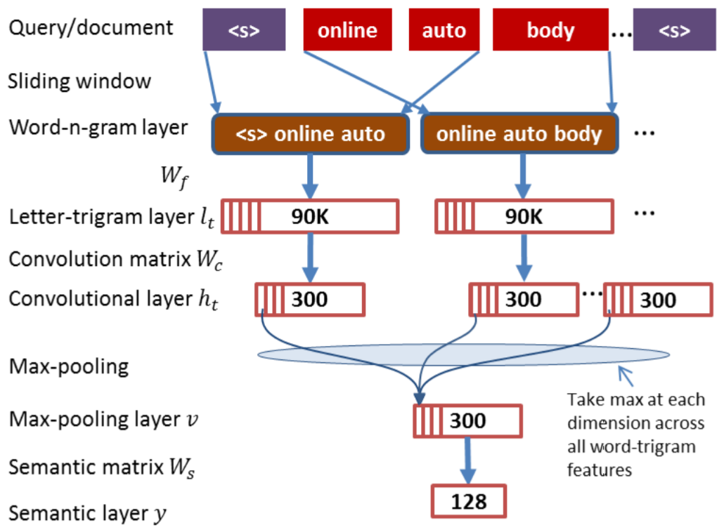
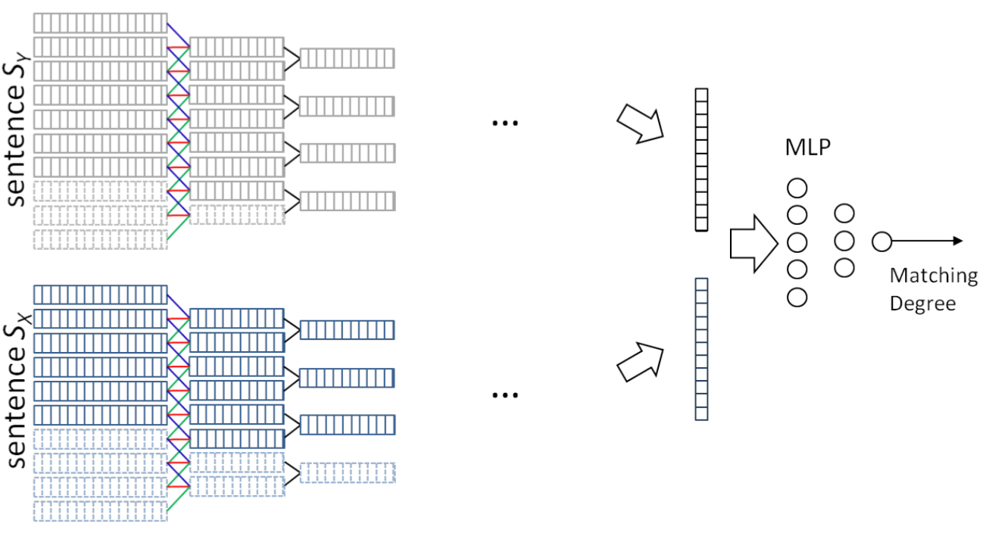
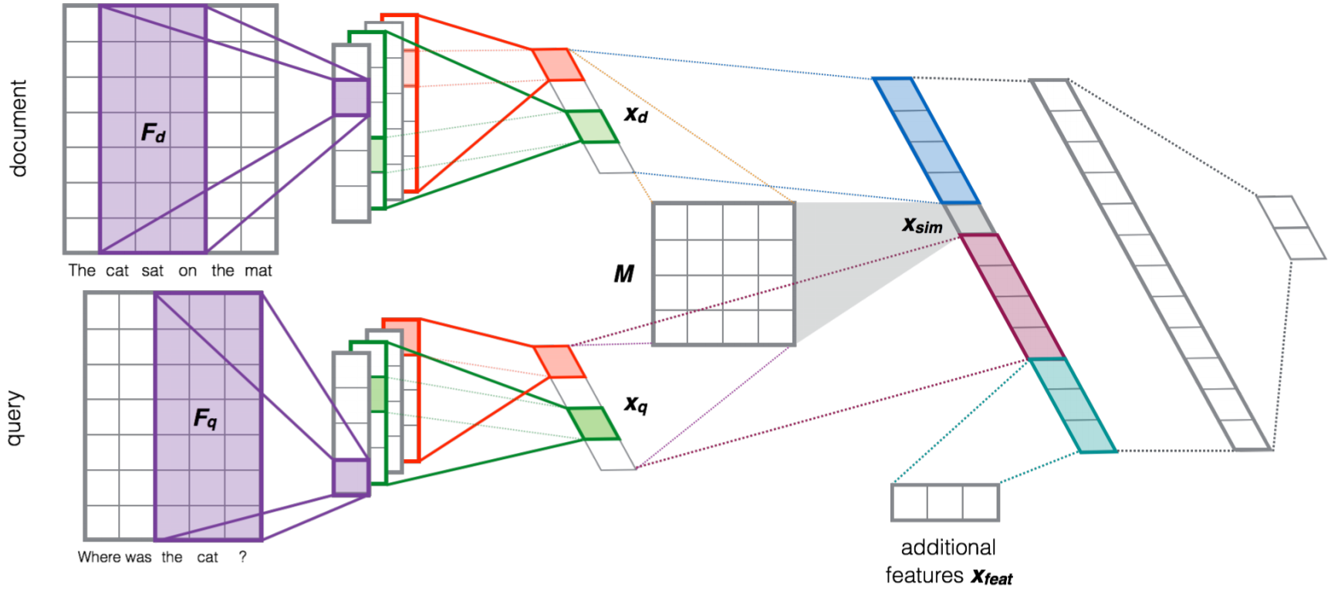
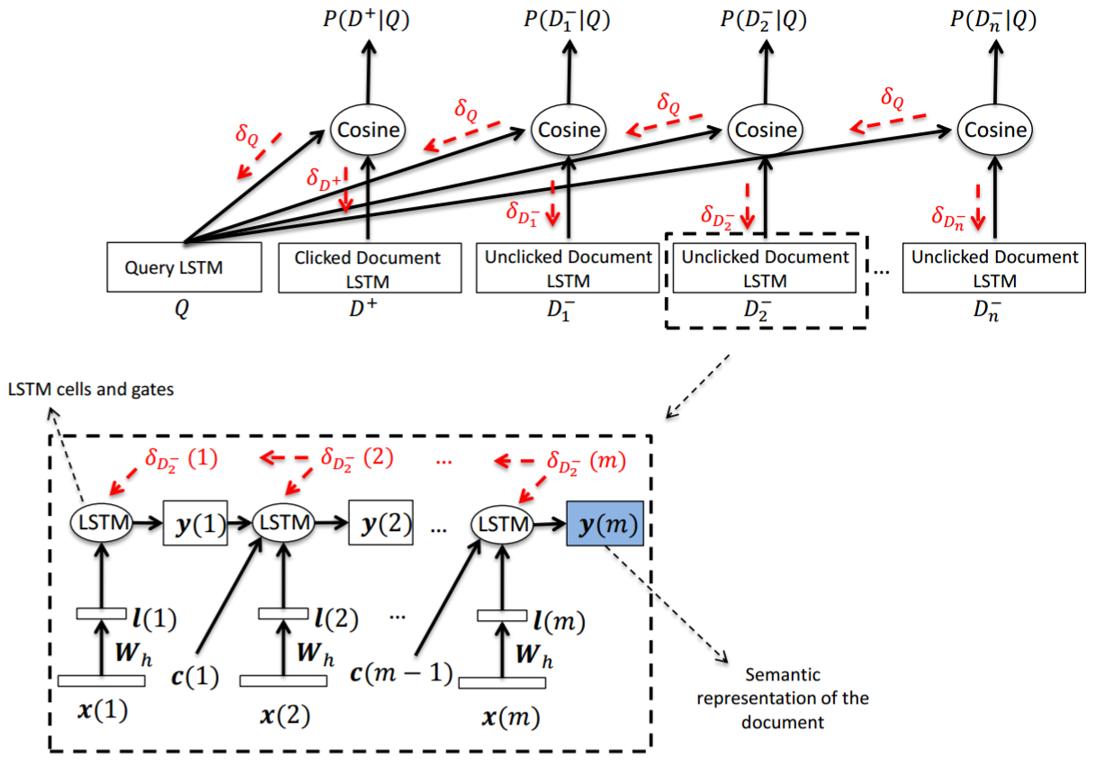
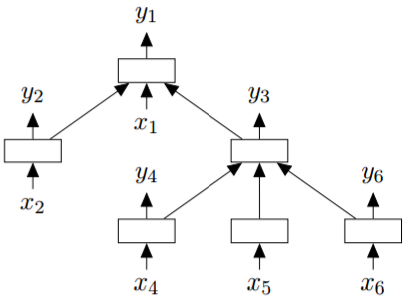
Many DNN models for short text ranking
(Huang et al., 2013)
(Hu et al., 2014)
(Shen et al., 2014)
(Severyn and Moschitti, 2015)
(Tai et al., 2015)
(Palangi et al., 2015)

Slide 7
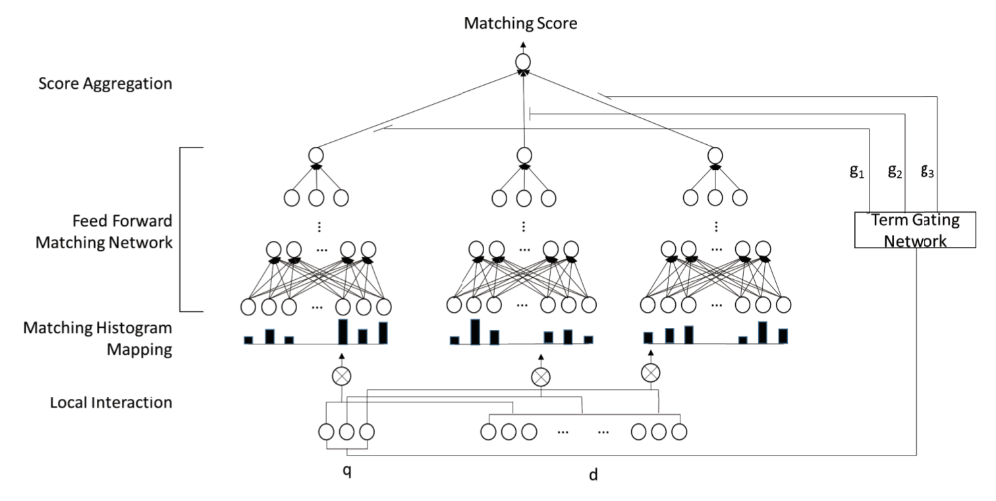
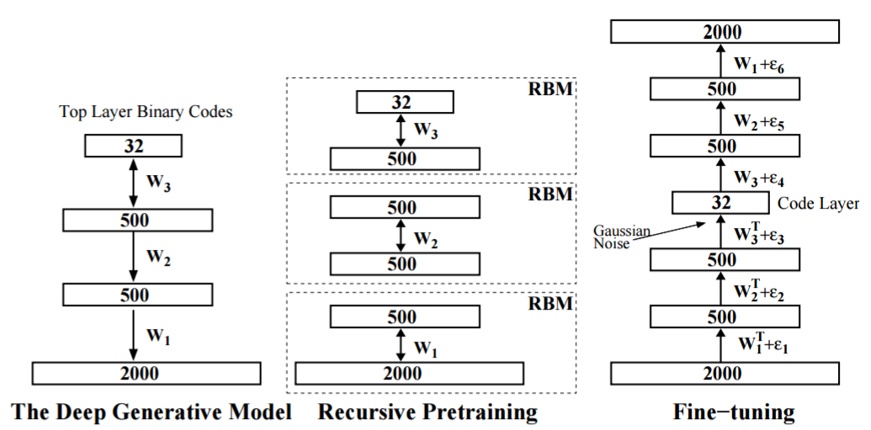
But few for long document ranking…
(Salakhutdinov and Hinton, 2009)
(Guo et al., 2016)

Slide 8
Desiderata of document ranking
Exact matching
Inexact matching
Frequency and positions of matches good indicators of relevance
Term proximity is important
Important if query term is rare / fresh
Synonymy relationships
united states president ↔ Obama
Evidence for document aboutness
Documents about Australia likely to contain related terms like Sydney and koala
Proximity and position is important

Slide 9
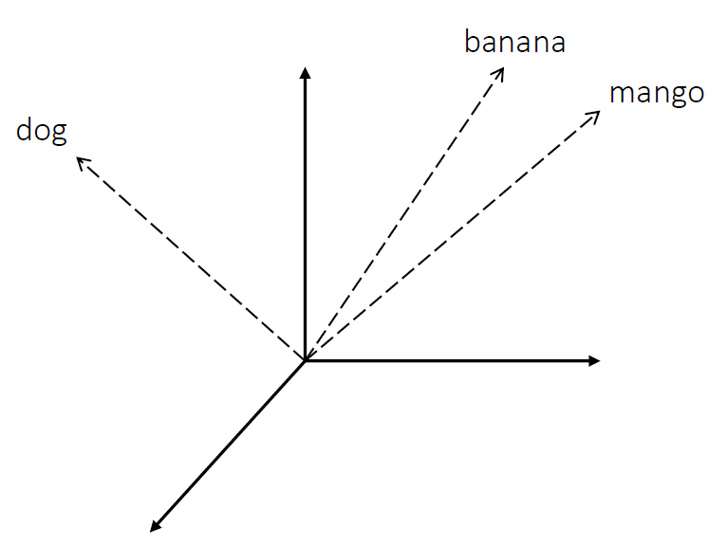
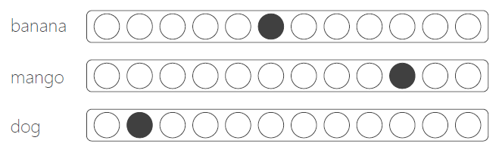
Different text representations for matching
Local representation
Distributed representation
Terms are considered distinct entities
Term representation is local (one-hot vectors)
Matching is exact (term-level)
Represent text as dense vectors (embeddings)
Inexact matching in the embedding space
Local (one-hot) representation
Distributed representation

Slide 10
A tale of two queries
“pekarovic land company”
“what channel are the seahawks on today”
Hard to learn good representation for rare term pekarovic
But easy to estimate relevance based on patterns of exact matches
Proposal: Learn a neural model to estimate relevance from patterns of exact matches
Target document likely contains ESPN or sky sports instead of channel
An embedding model can associate ESPN in document to channel in query
Proposal: Learn embeddings of text and match query with document in the embedding space
The Duet Architecture
Use a neural network to model both functions and learn their parameters jointly

Slide 11
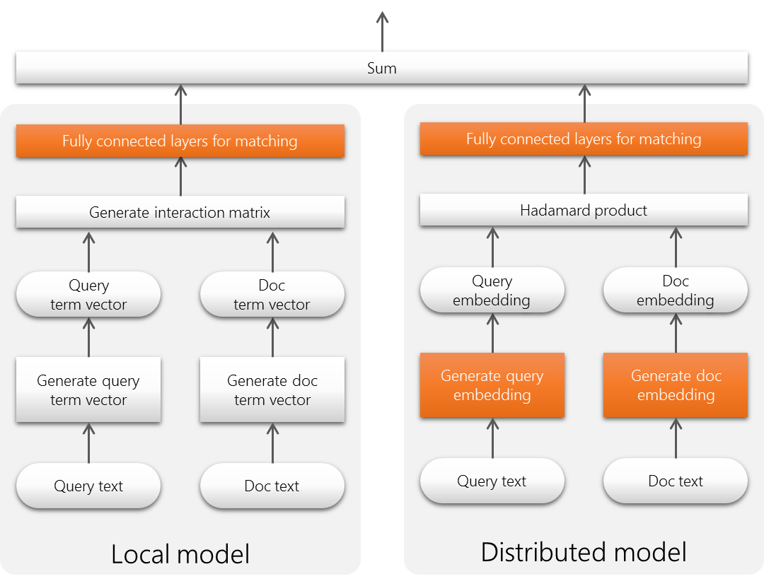
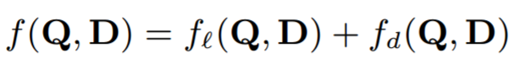
The Duet architecture
Linear combination of two models trained jointly on labelled query-document pairs
Local model operates on lexical interaction matrix
Distributed model projects n-graph vectors of text into an embedding space and then estimates match

Slide 12
Local sub-model
Focuses on patterns of exact matches of query terms in document

Slide 13
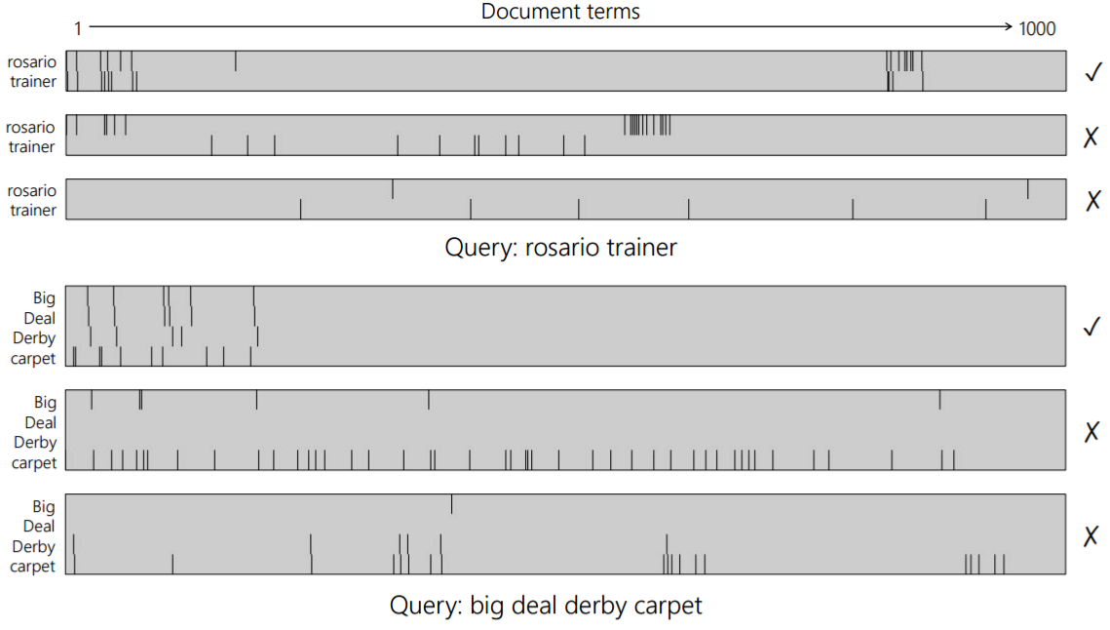
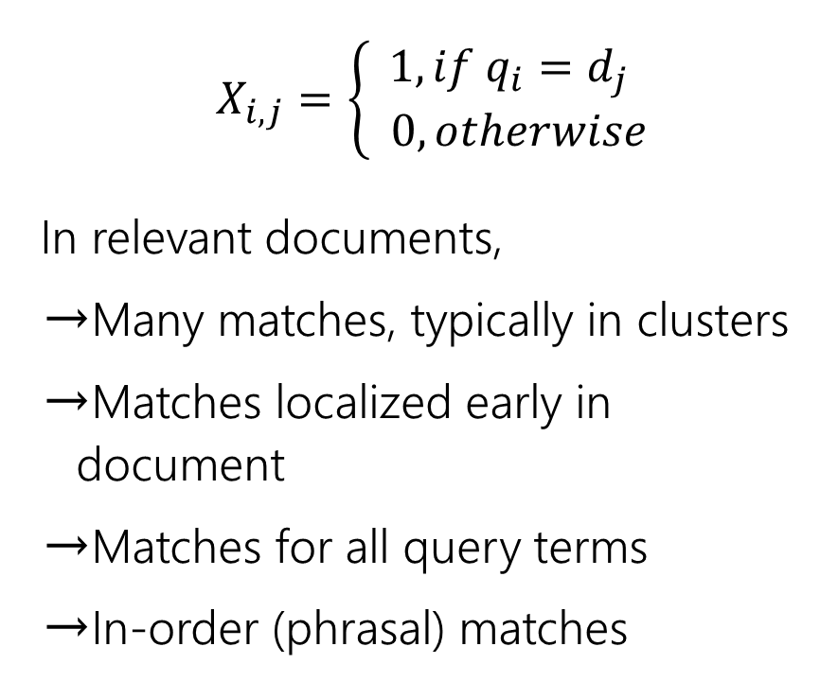
Interaction Matrix of query-document terms
$$X_{i,j}=\left\{\begin{aligned}1, if q_{i}=d_{j} \\ 0, otherwise\end{aligned}\right.$$
In relevant documents,
Many matches, typically in clusters
Matches localized early in document
Matches for all query terms
In-order (phrasal) matches

Slide 14
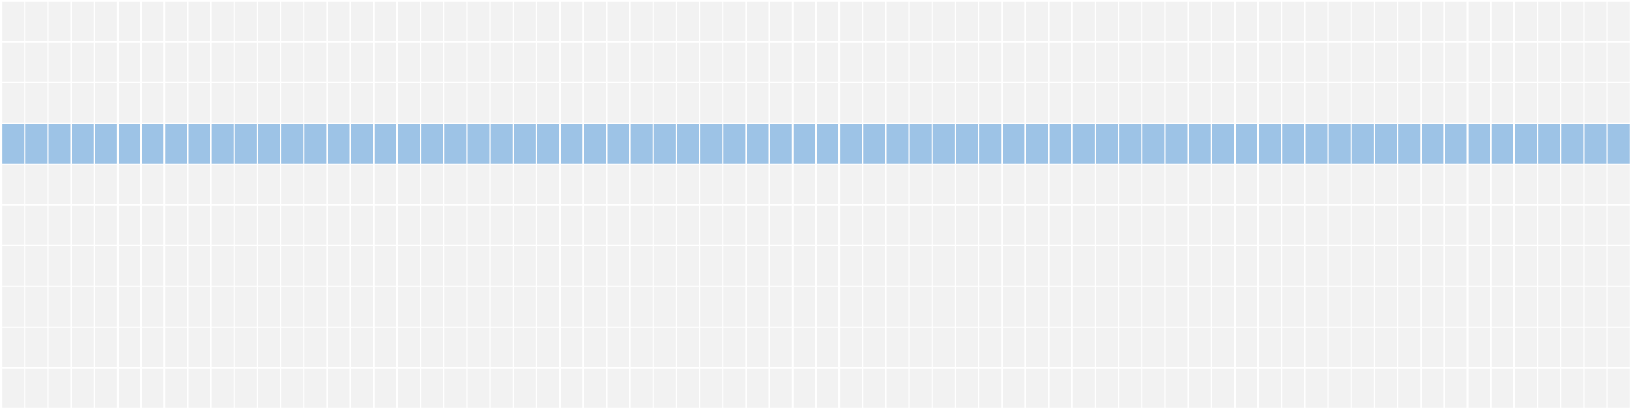
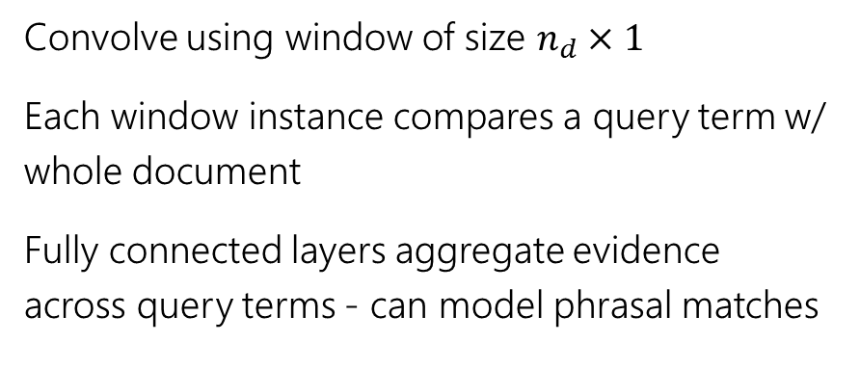
Estimating relevance from interaction matrix
Convolve using window of size $n_{d}×1$
Each window instance compares a query term w/ whole document
Fully connected layers aggregate evidence across query terms - can model phrasal matches
← query words →
← document words →

Slide 15
Local sub-model
Focuses on patterns of exact matches of query terms in document

Slide 16
The Duet architecture
Linear combination of two models trained jointly on labelled query-document pairs
Local model operates on lexical interaction matrix
Distributed model projects n-graph vectors of text into an embedding space and then estimates match

Slide 17
Distributed sub-model
Learns representation of text and matches query with document in the embedding space

Slide 18
Input representation
[words x channels]
concatenate
n-graph encoding
Channels = 2K
d o g s h a v e o w n e r s c a t s h a v e s t a f f
N-graph encoding
dogs → [ d , o , g , s , #d , do , og , gs , s# , #do , dog , ogs , gs#, #dog, dogs, ogs#, #dogs, dogs# ]
(we consider 2K most popular n-graphs only for encoding)

Slide 19
Estimating relevance from text embeddings
Convolve over query and document terms
Match query with moving windows over document
Learn text embeddings specifically for the task
Matching happens in embedding space
* Network architecture slightly simplified for visualization – refer paper for exact details
Fully connected
…
Hadamard product
Query embedding
Hadamard product
…
pooling
convolution
…
query
document

Slide 20
Putting the two models together…

Slide 21
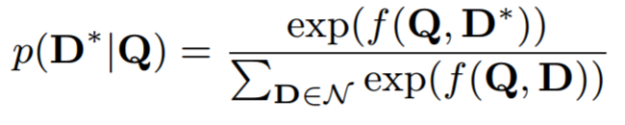
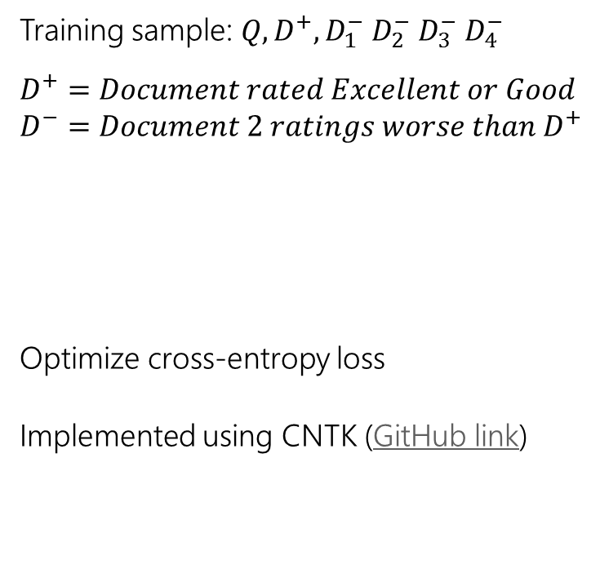
The Duet model
Training sample: $Q, D^{+},D_{1}^{−} D_{2}^{−} D_{3}^{−} D_{4}^{−}$
$$D^{+}=Document rated Excellent or Good$$
$$D^{−}=Document 2 ratings worse than D^{+}$$
Optimize cross-entropy loss
Implemented using CNTK (GitHub link)

Slide 22
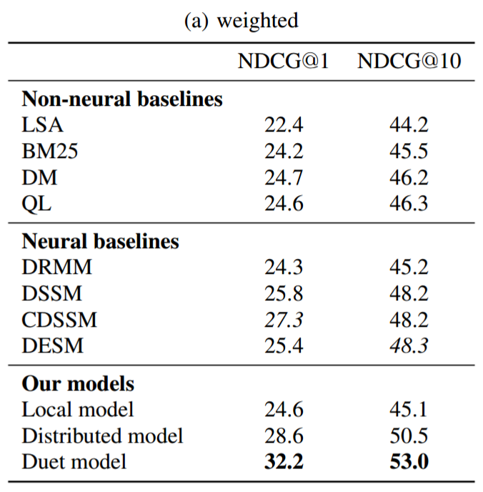
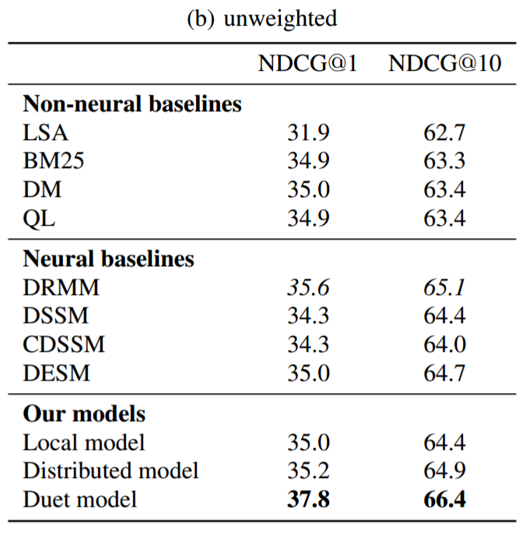
Results on document ranking
Key finding: Duet performs significantly better than local and distributed models trained individually

Slide 23
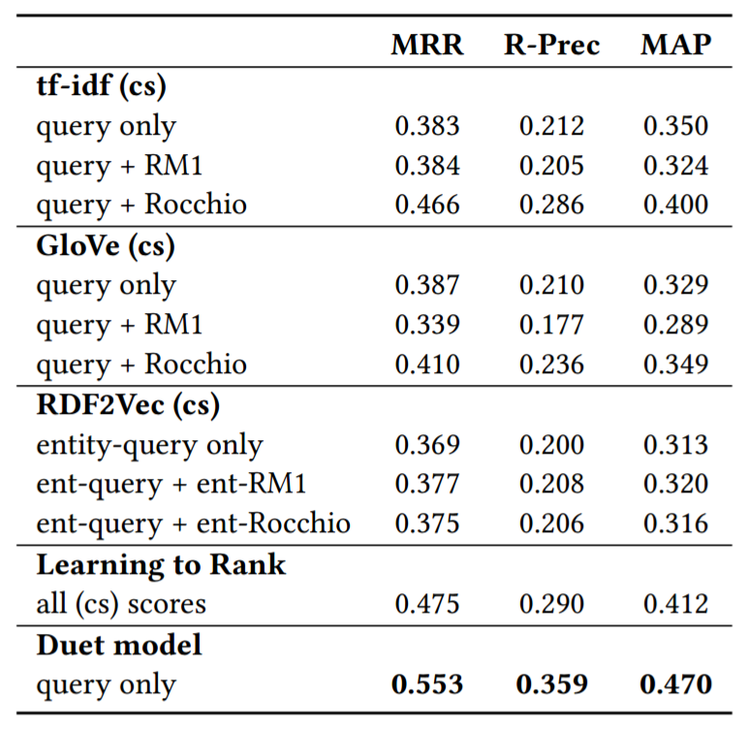
Duet on other IR tasks
Promising early results on TREC 2017 Complex Answer Retrieval (TREC-CAR)
Duet performs significantly better when trained on large data (~32 million samples)

Slide 24
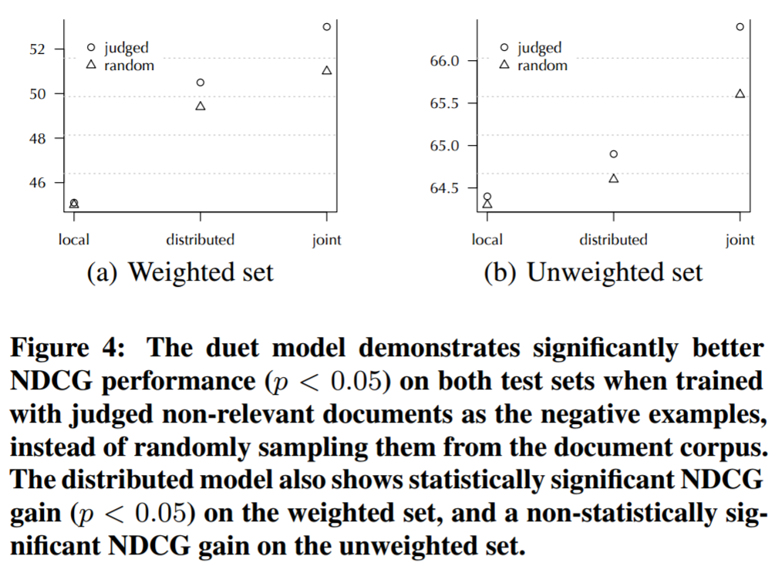
Random negatives vs. judged negatives
Key finding: training w/ judged bad as negatives significantly better than w/ random negatives

Slide 25
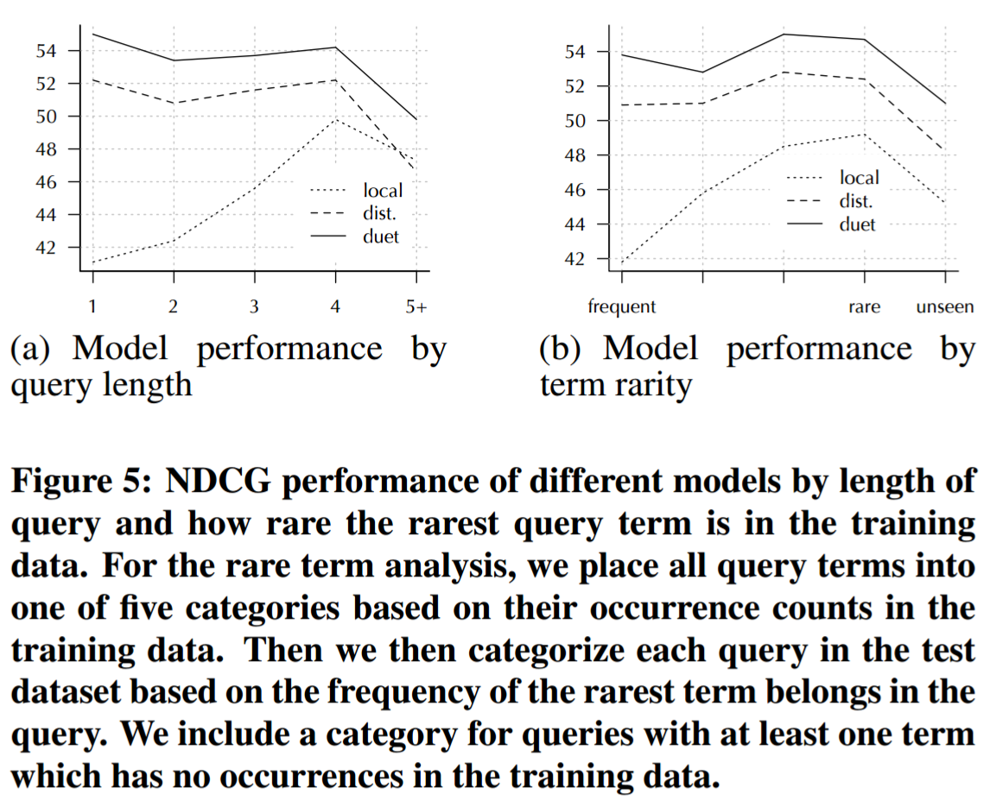
Local vs. distributed model
Key finding: local and distributed model performs better on different segments, but combination is always better

Slide 26
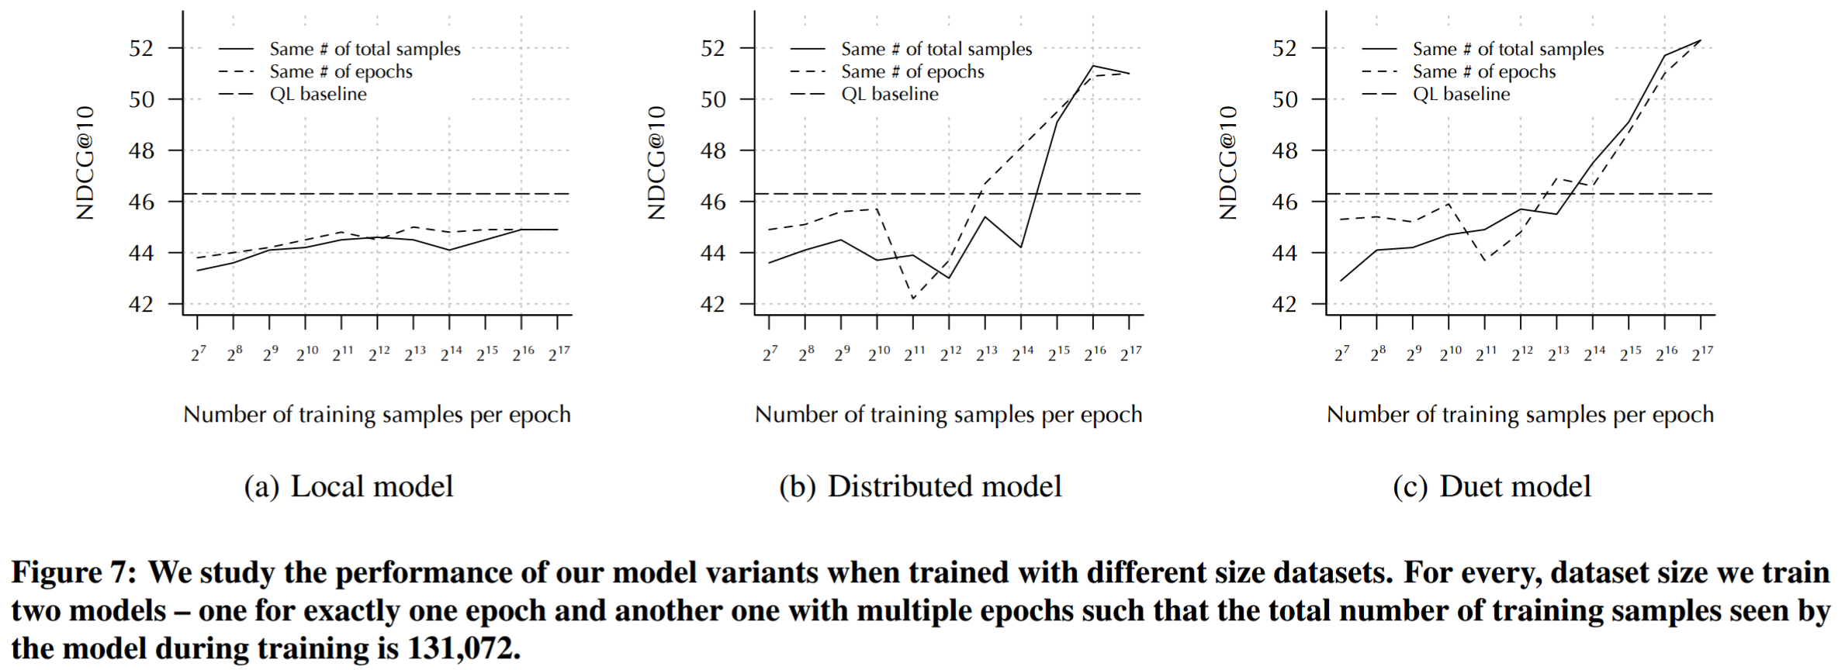
Effect of training data volume
Key finding: large quantity of training data necessary for learning good representations, less impactful for training local model

Slide 27
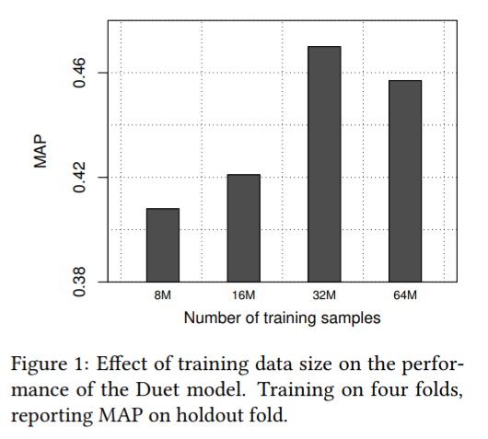
Effect of training data volume (TREC CAR)
Key finding: large quantity of training data necessary for learning good representations, less impactful for training local model

Slide 28
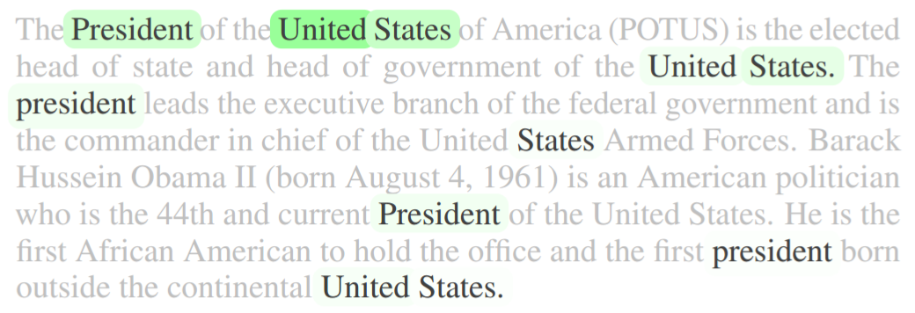
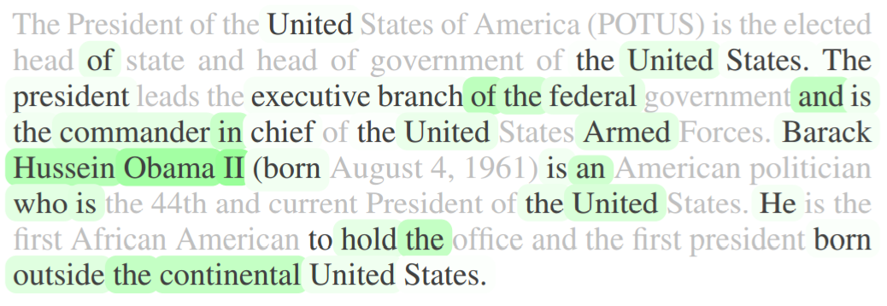
Term importance
Local model
Distributed model
Query: united states president

Slide 29
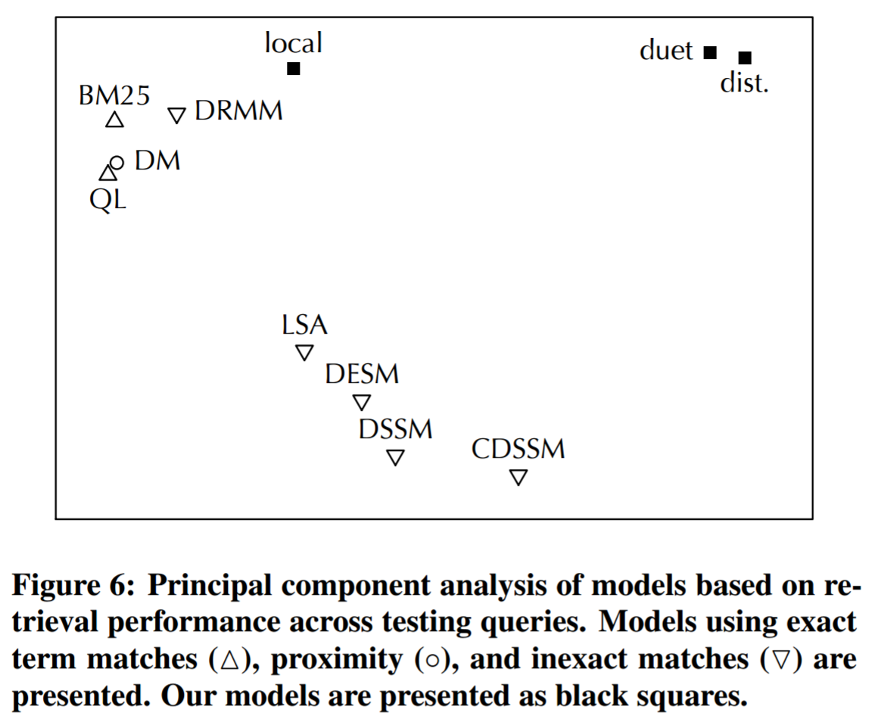
If we classify models by query level performance there is a clear clustering of lexical (local) and semantic (distributed) models

Slide 30
Get the code
Download
Implemented using CNTK python API
https://github.com/bmitra-msft/NDRM/blob/master/notebooks/Duet.ipynb

Slide 31
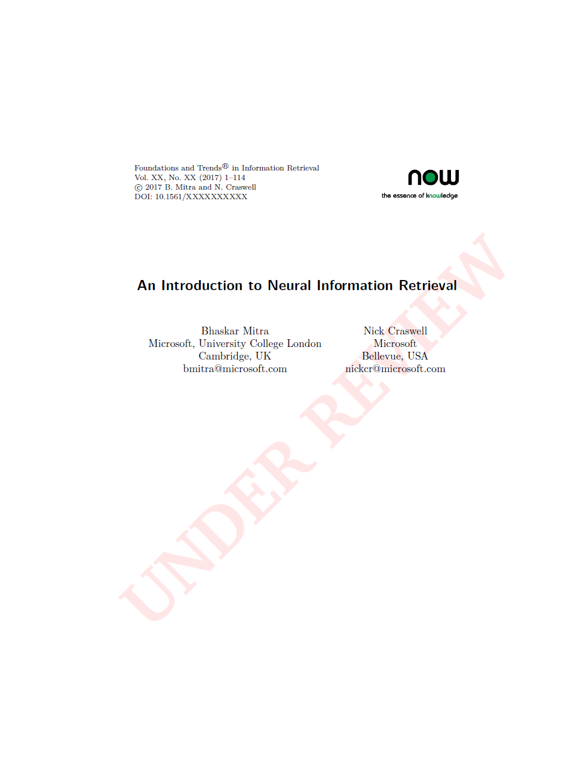
An introduction to Neural Information Retrieval
Manuscript under review for
Foundations and Trends® in Information Retrieval
Pre-print is available for free download
http://bit.ly/neuralir-intro
(Final manuscript may contain additional content and changes)
Thank You

